Slide 1
INTRODUCTION
We made a simple calculator.
WHOLE DETAIL OF THE CODING:
We use the standard code from tkinter. We call the constructor Tk( ) name gui now we call the background colour “Blue” and the title of the calculator shown in the top of the calculator application the title name is "SIMPLE BASIC CALCULATOR Made By MAHAD AND FAIZAN“. So now we needs two variable so we call the first variable is gui.geometry. Now we make the several variables such as button 1,2,3 4 and so on. The height of the buttons is “1” and the width is “7” we set the background colour of the buttons 1,2,3,4,5,6,7,8,9,0 and dot(.) is “green” and the fow ground colour is “black”. First we make a def fuction name “press(num)” so in the buttons variable we call the def function through lamda press(1,2..and so on). we use the command lamda, lamda is use to call the anonymous fuction. The buttons 1,2 and 3 is in row “1” and the column as 0,1,2. The button 4,5 and 6 is in row “3” and column as also 0,1,2. The button 7,8 and 9 is in row “4” and column is also 0,1,2. The button 0 is in row “5” and column 0.
And we make plus,minus,multiply and divide operators. The height of the operator is also “1” and the width is also “7” the background colour is “red” and the fow ground colour is “black”. In the operators variable we also call the def function through lamda press(+,-,* and /). The plus button in row “2” and column “3”. The minus button in row “3” column “3”.

Slide 2
The multiply button in row “4” column “3”. The button divide is in row “5” and column “3”
Now we make a new function for the equal button as def equalpress() and and is fuction eval is use for to calculate any input given by the calculator user and make as string beacause the answers should be in points so we make as str(eval) . Now make the variable for equal button is equal. In this variable we call the function equalpress to the output on the screen. The background colour of the equal button is “red” the height is “1” and width is “7” and fow ground colour is “black” . The equal button is in row “5” and column “2”.
Now in the end we make another fuction for clear button as def clear() if the user put the wrong input so this is why we make the clear button to erase the wrong input. Now we make the variable for clear button as clear. In this variable we call the function clear. The background colour of the clear button is “red” the height is “1” and the width is “7” . The clear button is in row “5” and column “1”.We make decimal(.) variable for decimal. The background decimal(.) button is “green” the height is “1” and width is “7” and fow ground is “black”. The decimal(.) button is in row “6” and column “0”.
In the end we make mainloop().In the mainloop the whole gui is work so that’s why we use mainloop.
Now run the code.

Slide 3
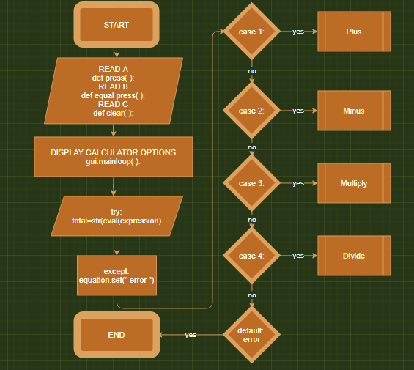
FLOW CHART

Slide 4
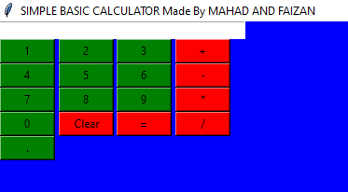
RESULT AND CONCLUSION
Here is our calculator we perform four mathematical operations plus,minus,multiply and divide.

